Slide 1
SQL Project
Work on Employment Details Database
Work by
-Vijay Adithya R S

Slide 2
SQL Basics
SQL Servers
DBMS and RDBMS
Database and Datatypes
MySQL Main Commands
CONTENTS
MySQL General Functions
MySQL Calculate Functions
MySQL String Functions
MySQL Date Functions
Logical Functions
Joins
Procedures and Triggers

Slide 3

SQL
SQL stands for Structured Query Language
Structured query language (SQL) is a programming language for storing and processing information in a relational database.
A relational database stores information in tabular form, with rows and columns representing different data attributes and the various relationships between the data values.

Slide 4
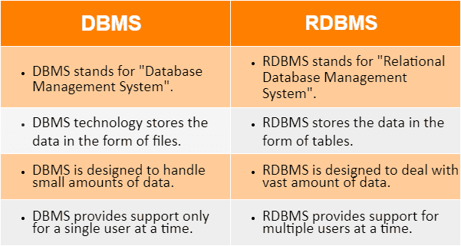
DBMS and RDBMS

Slide 5




Database
A database is a structured way of storing information.
Databases can store large amounts of data, such as credit card transactions, social media clicks, etc.
They can be stored on computers, servers, or in the cloud.
Several companies offer database management platforms designed for efficient data storage and management.

Slide 6
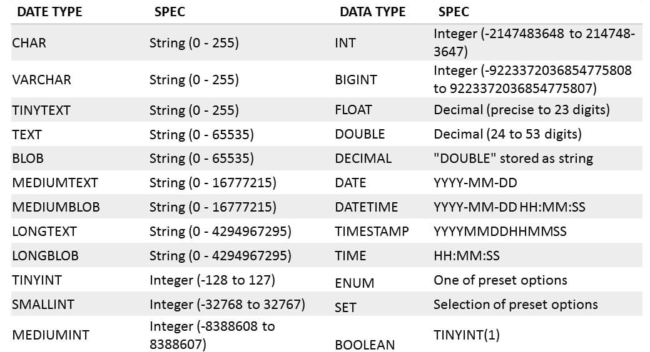
Data Types

Slide 7
MySQL Main Commands
Create Database Query
create database besantproject001;
Use Database Query
use besantproject001;

Slide 8
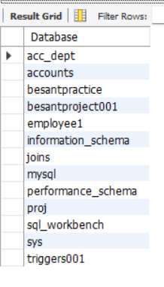
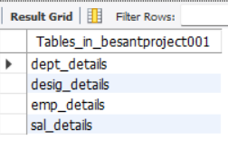
MySQL Main Commands
Show Databases Query
Show Tables Query
show databases;
show tables;

Slide 9
MySQL Main Commands
Drop Database Query
drop database dummy01;
Insert Values into table
insert into emp_details values (17034, 'Vijay', 3003, 50, '2022-08-31');

Slide 10
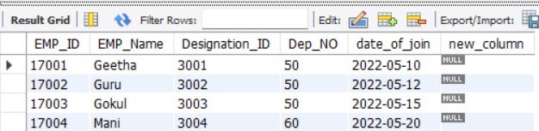
MySQL Main Commands
Drop Table Query
drop table dummy_table;
Alter Table (for new column creation)
alter table emp_details add column new_column varchar(20);

Slide 11
MySQL Main Commands
Alter Table (Modify Column)
alter table emp_details modify new_column int;
Alter Table (drop column)
alter table emp_details drop column new_column;

Slide 12
MySQL Main Commands
Alter Table (Rename Table)
alter table emp_details rename employee_details;
Update Table
update emp_details set emp_name = 'Vijay Adithya' where emp_id = 17034;

Slide 13
MySQL Main Commands
Delete Statement
delete from emp_details where emp_id = 17034;

Slide 14
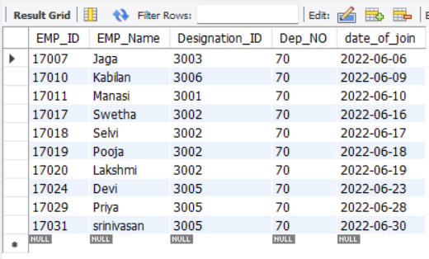
MySQL General Functions
Where Clause
select * from emp_details WHERE dep_no = 70;

Slide 15
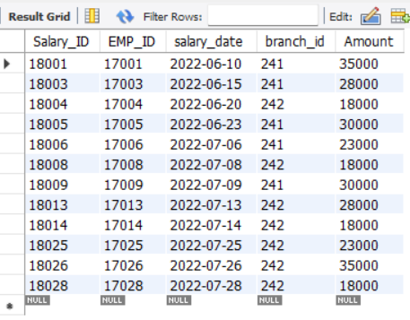
MySQL General Functions
AND and OR keywords
select * from sal_details where (branch_id = 241 or branch_id = 242)and amount >= 15000;

Slide 16
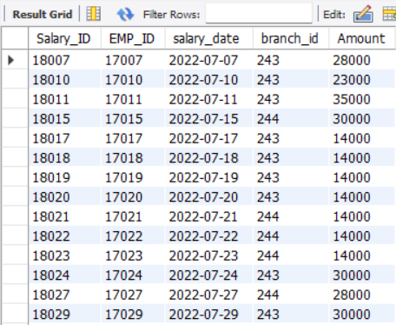
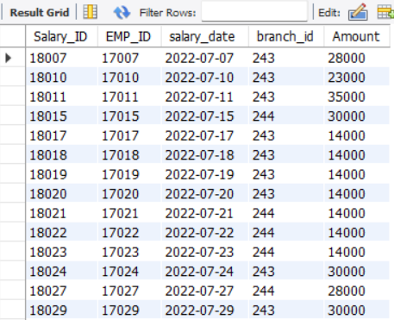
MySQL General Functions
IN and NOT IN keywords
select * from sal_details where branch_id in (243, 244);
select * from sal_details where branch_id not in (241, 242);

Slide 17
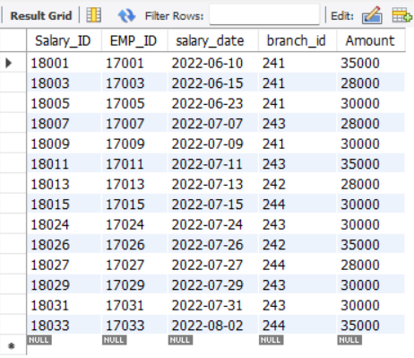
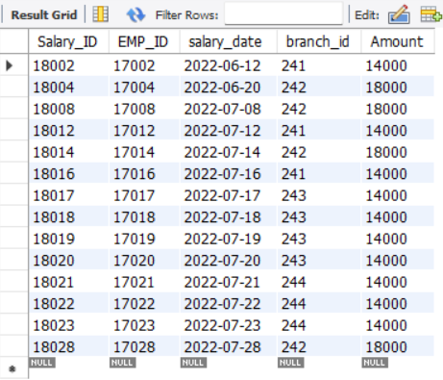
MySQL General Functions
Relational Operators
select * from sal_details where amount >= 25000;
select * from sal_details where amount < 20000;

Slide 18
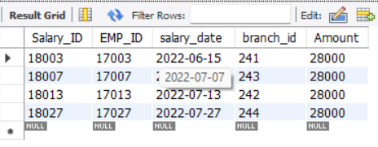
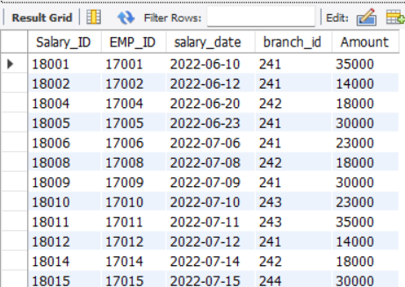
MySQL General Functions
Relational Operators
select * from sal_details where amount = 28000;
select * from sal_details where amount <> 28000;

Slide 19
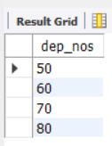

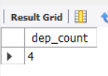
MySQL General Functions
COUNT, DISTINCT, COUNT with DISTINCT keywords
select count(emp_id) as dep_count from emp_details where dep_no = 50;
select distinct(dep_no) as dep_nos from emp_details;
select count(distinct(dep_no)) as dep_count from emp_details;

Slide 20
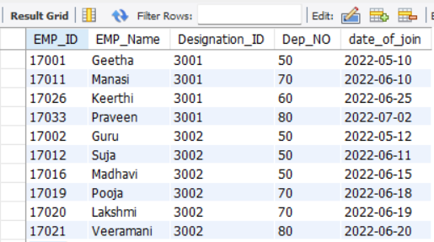
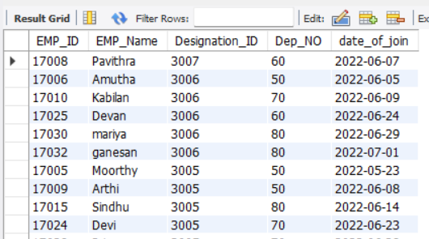
MySQL General Functions
ORDER BY and ORDER BY DESC clauses
select * from emp_details order by designation_id;
select * from emp_details order by designation_id desc;

Slide 21
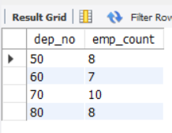
MySQL General Functions
GROUP BY clause
select dep_no, count(emp_id) as emp_count from emp_details group by dep_no;

Slide 22
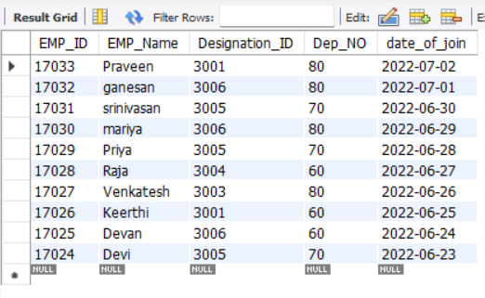
MySQL General Functions
LIMIT and DESC LIMIT keywords
select * from emp_details limit 10;
select * from emp_details order by emp_id desc limit 10;

Slide 23
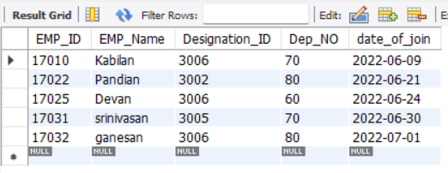
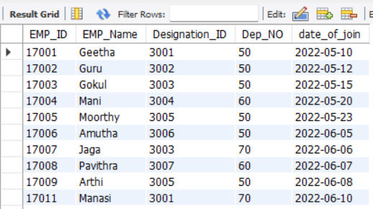
MySQL General Functions
LIKE and NOT LIKE keywords
select * from emp_details where emp_name like '%an';
select * from emp_details order by emp_id desc limit 10;

Slide 24
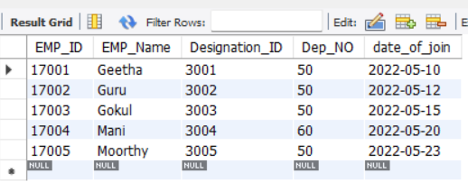
MySQL General Functions
BETWEEN keyword
select * from emp_details where date_of_join between '2022-05-0' and '2022-06-01';

Slide 25


MySQL Calculate Functions
SUM and AVERAGE Functions
select sum(amount) as branch_241_amount from sal_details where branch_id = 241;
select avg(amount) as branch_241_average from sal_details where branch_id = 241;

Slide 26


MySQL Calculate Functions
MIN and MAX functions
select max(amount) as min_amount from sal_details;
select min(amount) as min_amount from sal_details;

Slide 27

MySQL Calculate Functions
MIN, MAX and COUNT functions
select max(amount) as min_amount from sal_details;
select min(amount) as min_amount from sal_details;
select count(salary_id) as sal_count from sal_details;

Slide 28
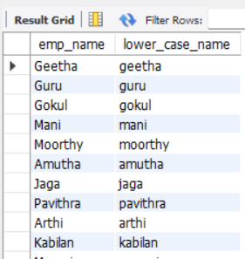
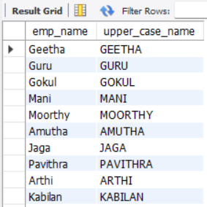
MySQL String Functions
LCASE and UCASE functions
select emp_name, lcase(emp_name) as lower_case_name from emp_details;
select emp_name, ucase(emp_name) as upper_case_name from emp_details;

Slide 29
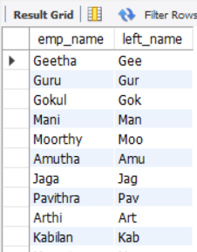
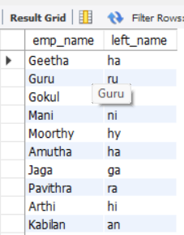
MySQL String Functions
LEFT and RIGHT functions
select emp_name, left(emp_name, 3) as left_name from emp_details;
select emp_name, right(emp_name, 2) as left_name from emp_details;

Slide 30
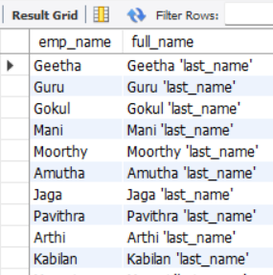

MySQL String Functions
CONCAT and TRIM Functions
select emp_name, concat(emp_name, " 'last_name'") as full_name from emp_details;
select trim(' Vijay Adithya R S ') as trim_function_output;

Slide 31
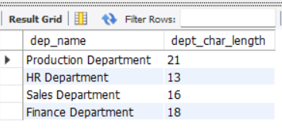
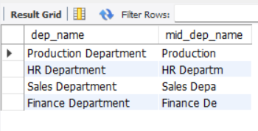
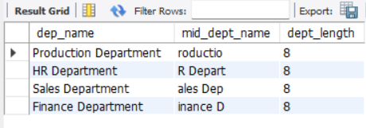
MySQL String Functions
CHAR-LENGTH, MID and LENGTH Functions
select dep_name, char_length(dep_name) as dept_char_length from dept_details;
select dep_name, mid(dep_name, 1, 10) as mid_dep_name from dept_details;
select dep_name, mid(dep_name, 2, 8) as mid_dept_name, length(mid(dep_name, 2, 8)) as dept_length from dept_details;

Slide 32
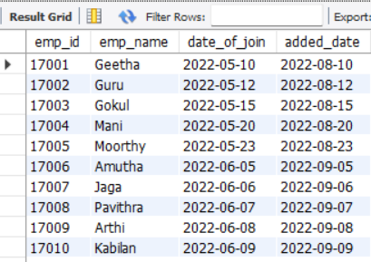
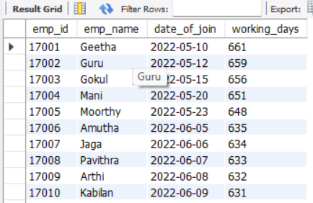
MySQL Date Functions
DATE_ADD and DATEDIFF Functions
select emp_id, emp_name, date_of_join, date_add(date_of_join, interval 3 month) as added_date from emp_details;
select emp_id, emp_name, date_of_join, datediff(curdate(), date_of_join) as working_days from emp_details;

Slide 33
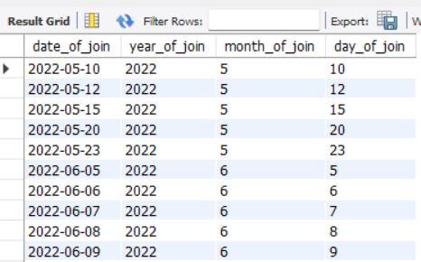
MySQL Date Functions
DATE FORMATS : Year, Month, Day
select date_of_join, year(date_of_join) as year_of_join, month(date_of_join) as month_of_join, day(date_of_join) as day_of_join from emp_details;

Slide 34
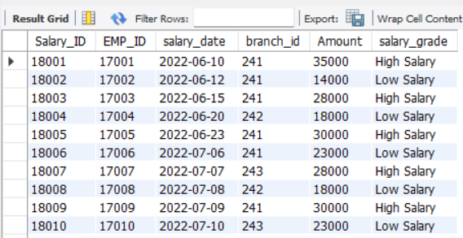
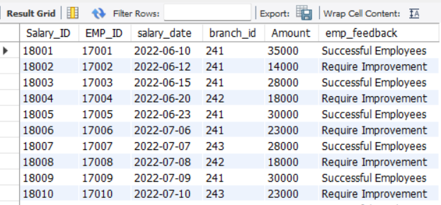
MySQL Logical Functions
IF, IF with AND, IF with OR conditions
select *, if((((branch_id = 241) or (branch_id = 243)) and amount > 25000), 'Successful Employees', 'Require Improvement') as emp_feedback from sal_details;
select *, if(amount>=25000, 'High Salary','Low Salary') as salary_grade from sal_details;

Slide 35

MySQL Date Functions
COUNT IF Function
select count(if(amount>=25000, 1, null)) as good_salary_count from sal_details;

Slide 36
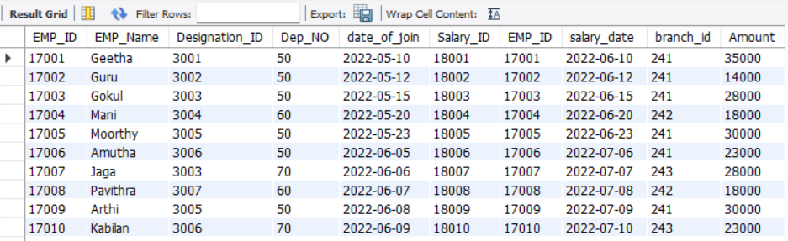
MySQL RDBMS Concepts
Connecting 2 Tables
select * from emp_details e, sal_details s where e.emp_id = s.emp_id;

Slide 37
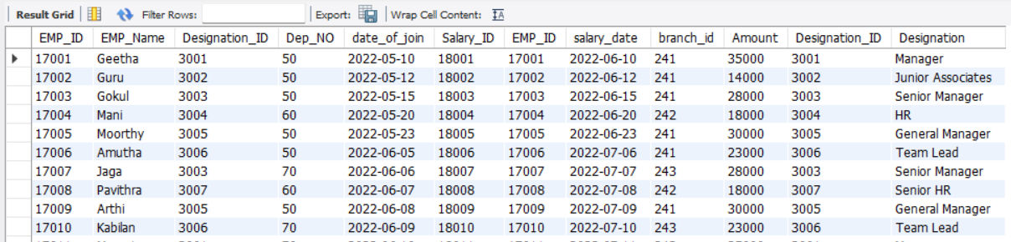
MySQL RDBMS Concepts
Connecting 3 Tables
select * from emp_details e, sal_details s, desig_details d where e.emp_id = s.emp_id and e.designation_id = d.designation_id;

Slide 38
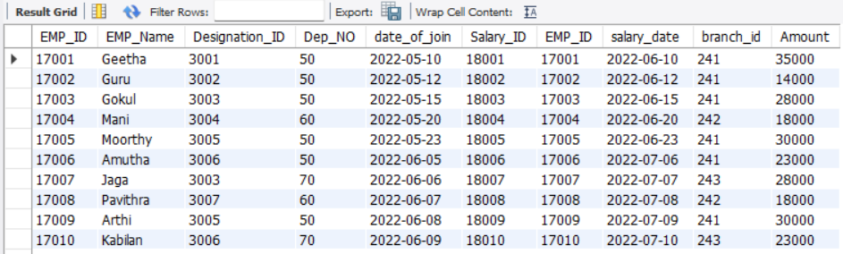
MySQL Joins
Inner Join
select * from emp_details e inner join sal_details s on e.emp_id = s.emp_id;

Slide 39
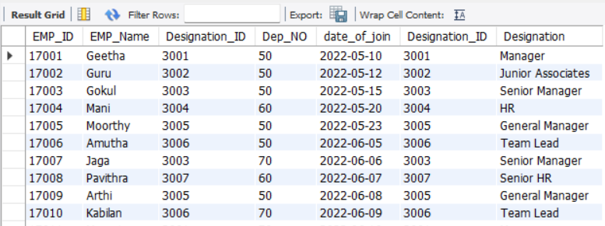
MySQL Joins
Left Join
select * from emp_details e left join desig_details d on e.designation_id = d.designation_id;

Slide 40
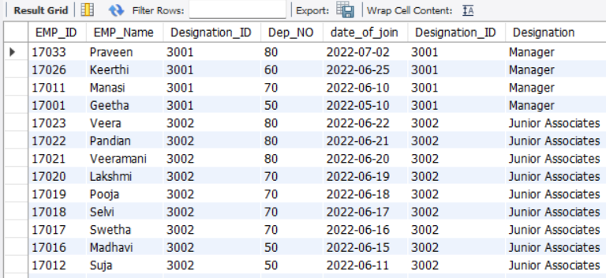
MySQL Joins
Right Join
select * from emp_details e right join desig_details d on e.designation_id = d.designation_id;

Slide 41
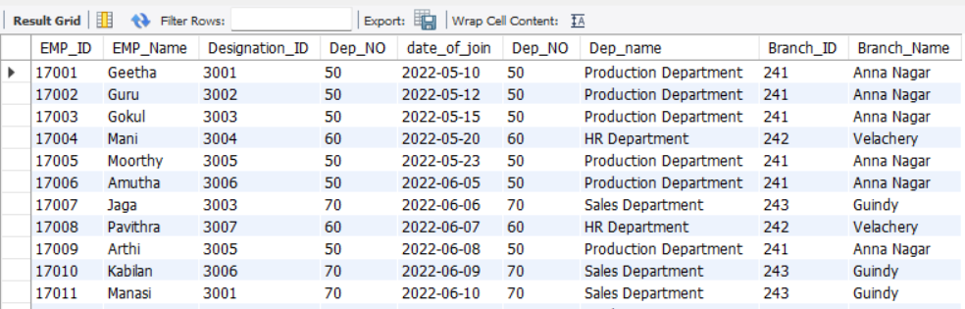
MySQL Joins
Full Outer Join
select * from emp_details e join dept_details d on e.dep_no = d.dep_no;

Slide 42
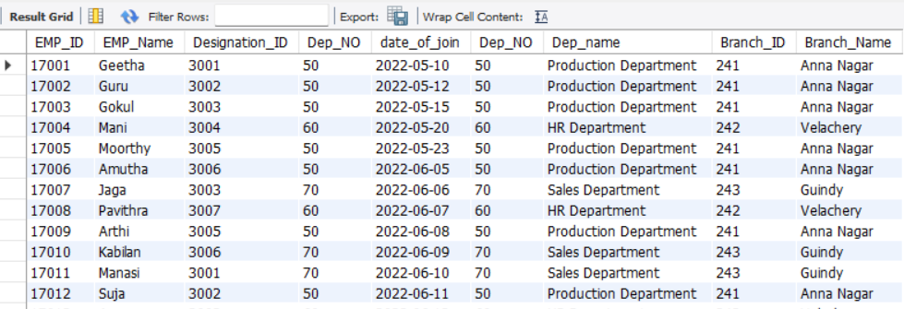
MySQL Joins
Cross Join
select * from emp_details e cross join desig_details d on e.designation_id = d.designation_id;

Slide 43
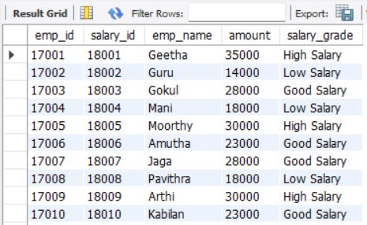
MySQL Joins
CASE END, (using WHEN, THEN keywords)
select e.emp_id, s.salary_id, e.emp_name, s.amount,case when s.amount >= 30000 then 'High Salary' when s.amount >= 20000 then 'Good Salary' when s.amount >= 10000 then 'Low Salary'end as salary_grade from emp_details e inner join sal_details s on e.emp_id = s.emp_id;

Slide 44
Add Your Website
Enter title
THANKS
Click here to add content of the text，and briefly explain your point of view
Enter title

